Slide 1
Tutorial 5
Ziren
u4975835@anu.edu.au
Thursday 10 am to 11am
CBE 3.09

Slide 2
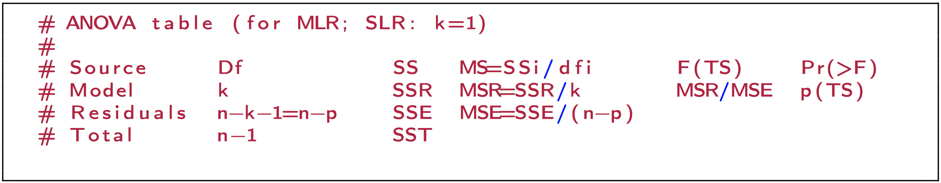
Anova

Slide 3
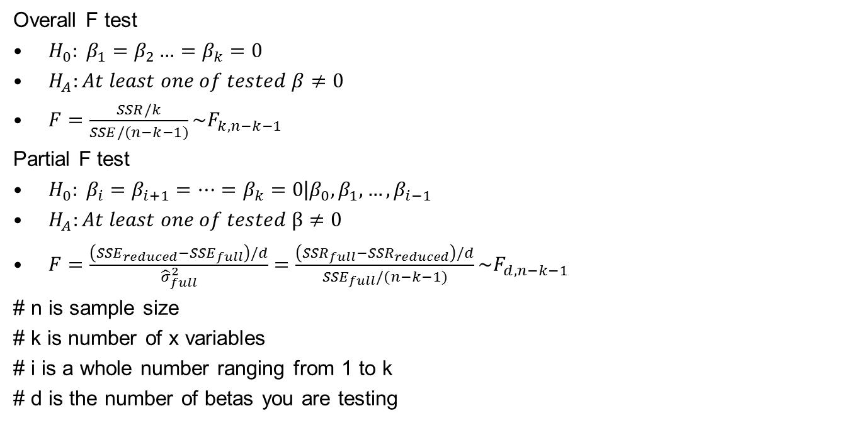
F Test
Overall F test
$H_{0}: β_{1}=β_{2}…=β_{k}=0$
$H_{A}:At least one of tested β≠0$
$F=\frac{SSR/k}{SSE/(n−k−1)}\sim F_{k,n−k−1}$
Partial F test
$H_{0}: β_{i}=β_{i+1}=…=β_{k}=0\text{|}β_{0},β_{1},…,β_{i−1}$
$H_{A}:At least one of tested β≠0$
$F=\frac{\left({SSE}_{reduced}−{SSE}_{full}\right)/d}{{\hat{σ}}_{full}^{2}}=\frac{\left({SSR}_{full}−{SSR}_{reduced}\right)/d}{{SSE}_{full}/(n−k−1)}\sim F_{d,n−k−1}$
# n is sample size
# k is number of x variables
# i is a whole number ranging from 1 to k
# d is the number of betas you are testing

Slide 4
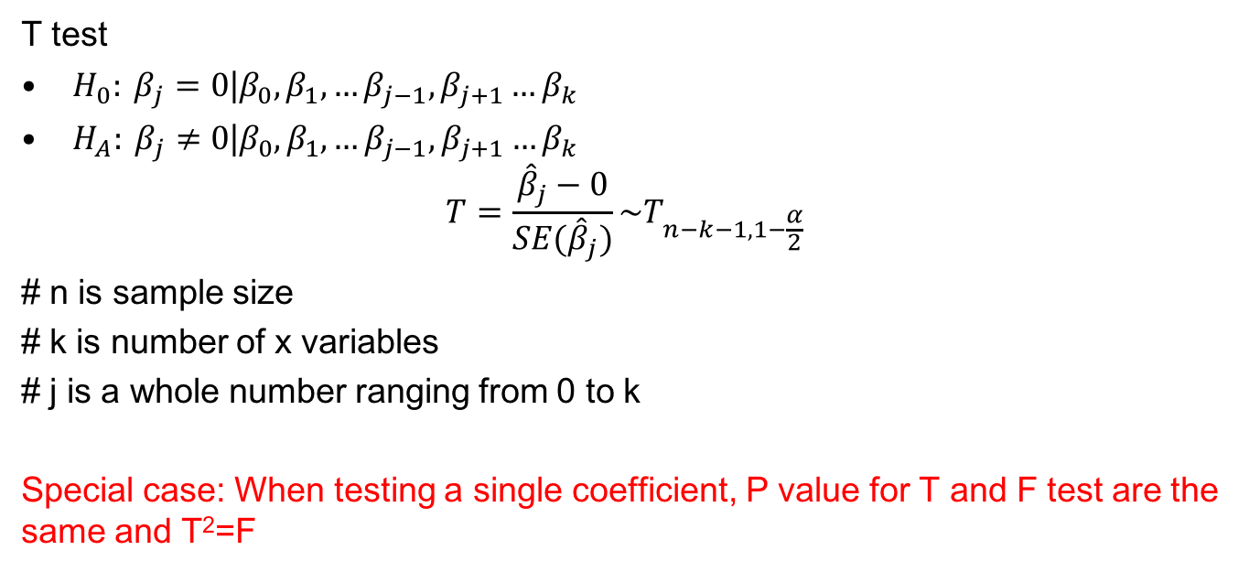
T Test
T test
$H_{0}: β_{j}=0\text{|}β_{0},β_{1},…β_{j−1},β_{j+1}…β_{k}$
$H_{A}: β_{j}≠0\text{|}β_{0},β_{1},…β_{j−1},β_{j+1}…β_{k}$
$$T=\frac{{\hat{β}}_{j}−0}{SE({\hat{β}}_{j})}\sim T_{n−k−1,1−\frac{α}{2}}$$
# n is sample size
# k is number of x variables
# j is a whole number ranging from 0 to k
Special case: When testing a single coefficient, P value for T and F test are the same and T²=F

Slide 5
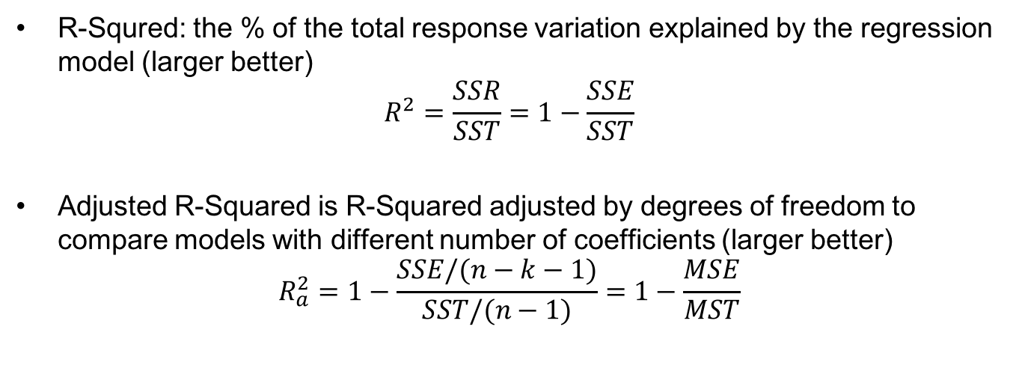
R-Squared and Adjusted R-Squared
R-Squred: the % of the total response variation explained by the regression model (larger better)
$$R^{2}=\frac{SSR}{SST}=1−\frac{SSE}{SST}$$
Adjusted R-Squared is R-Squared adjusted by degrees of freedom to compare models with different number of coefficients (larger better)
$$R_{a}^{2}=1−\frac{SSE/(n−k−1)}{SST/(n−1)}=1−\frac{MSE}{MST}$$

Slide 6
Graphical Tools for Model Diagnostics
Leverage plot
If hi > 2(k + 1)/n, then observation i is an observation with distant explanatory variable values.
Standardized (Studentized) residuals versus fitted values plot
If |studresi |>1.96 (2), then observation i is an outlier.
Cook’s distance plot
If Di > 1, then the observation i is an influential observation.

Slide 7
Question 1
As part of a study of the effects of predatory intertidal crab species on snail populations, researchers measured the mean closing forces and the propodus heights of the claws on several crabs of three species. This data is contained in the file “crab.csv”.
What is a 95% CI for the amount by which the slope for Cancer productus exceeds the slope for Hemigrapsus nududus?
Is the regression model fit in last week significant? Provide a p-value for the test.
Are the slopes of the regression lines the same for the three species? (Hint: You will need to use the anova() command and an F-test)

Slide 8
Question 2
The Old Faithful data used in class also contains a column called DATE. This column contains information on the day the data were collected. The data is contained in “oldfaithful.csv”. Fit the regression of interval on duration and date (use seven indicator variables to distinguish the eight dates). Construct an F-statistic for the test of whether any difference in mean intervals is due to the date of recording. Find the p-value.

Slide 9
Thank you~

